Slide 1

Workshop 2 Project : "Urban Greening for Healthy Breathing“ BGMK0300064 - UGHB Partners: Municipality of Kyustendil (Bulgaria), Municipality of Kumanovo, Center for Development of Third‑Northeast Planning Region. Kumanovo,26.07.2025

Slide 2
What green infrastructure is? - How it is being applied in Kumanovo. - Specific interventions under the project "Urban Greening for Healthy Breathing“. - Why green infrastructure is better than traditional urban infrastructure. - The long-term impact on health, environment, and city life.

Slide 3
What Is Green Infrastructure? - Green infrastructure refers to natural or semi-natural systems that provide environmental, economic, and health benefits. Examples: - Trees and green corridors - Parks and public green spaces - Green roofs and walls - Rain gardens and sustainable drainage systems

Slide 4
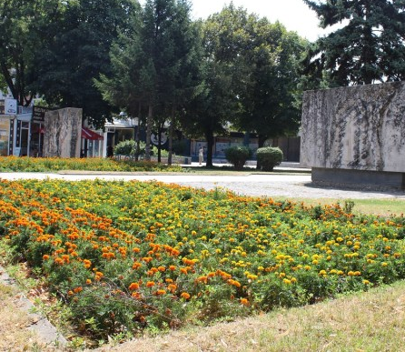
Difference from traditional (grey) infrastructure: Green - works with nature (trees, soil, water); Grey - hard materials like concrete, asphalt;

Slide 5
Why Green Infrastructure Matters? - Cleans the air by filtering pollutants; - Cools down cities (reduces urban heat) - Absorbs rainwater (reduces flooding) - Improves mental and physical health - Encourages biodiversity (birds, insects, etc.) - Makes cities more beautiful and livable

Slide 6
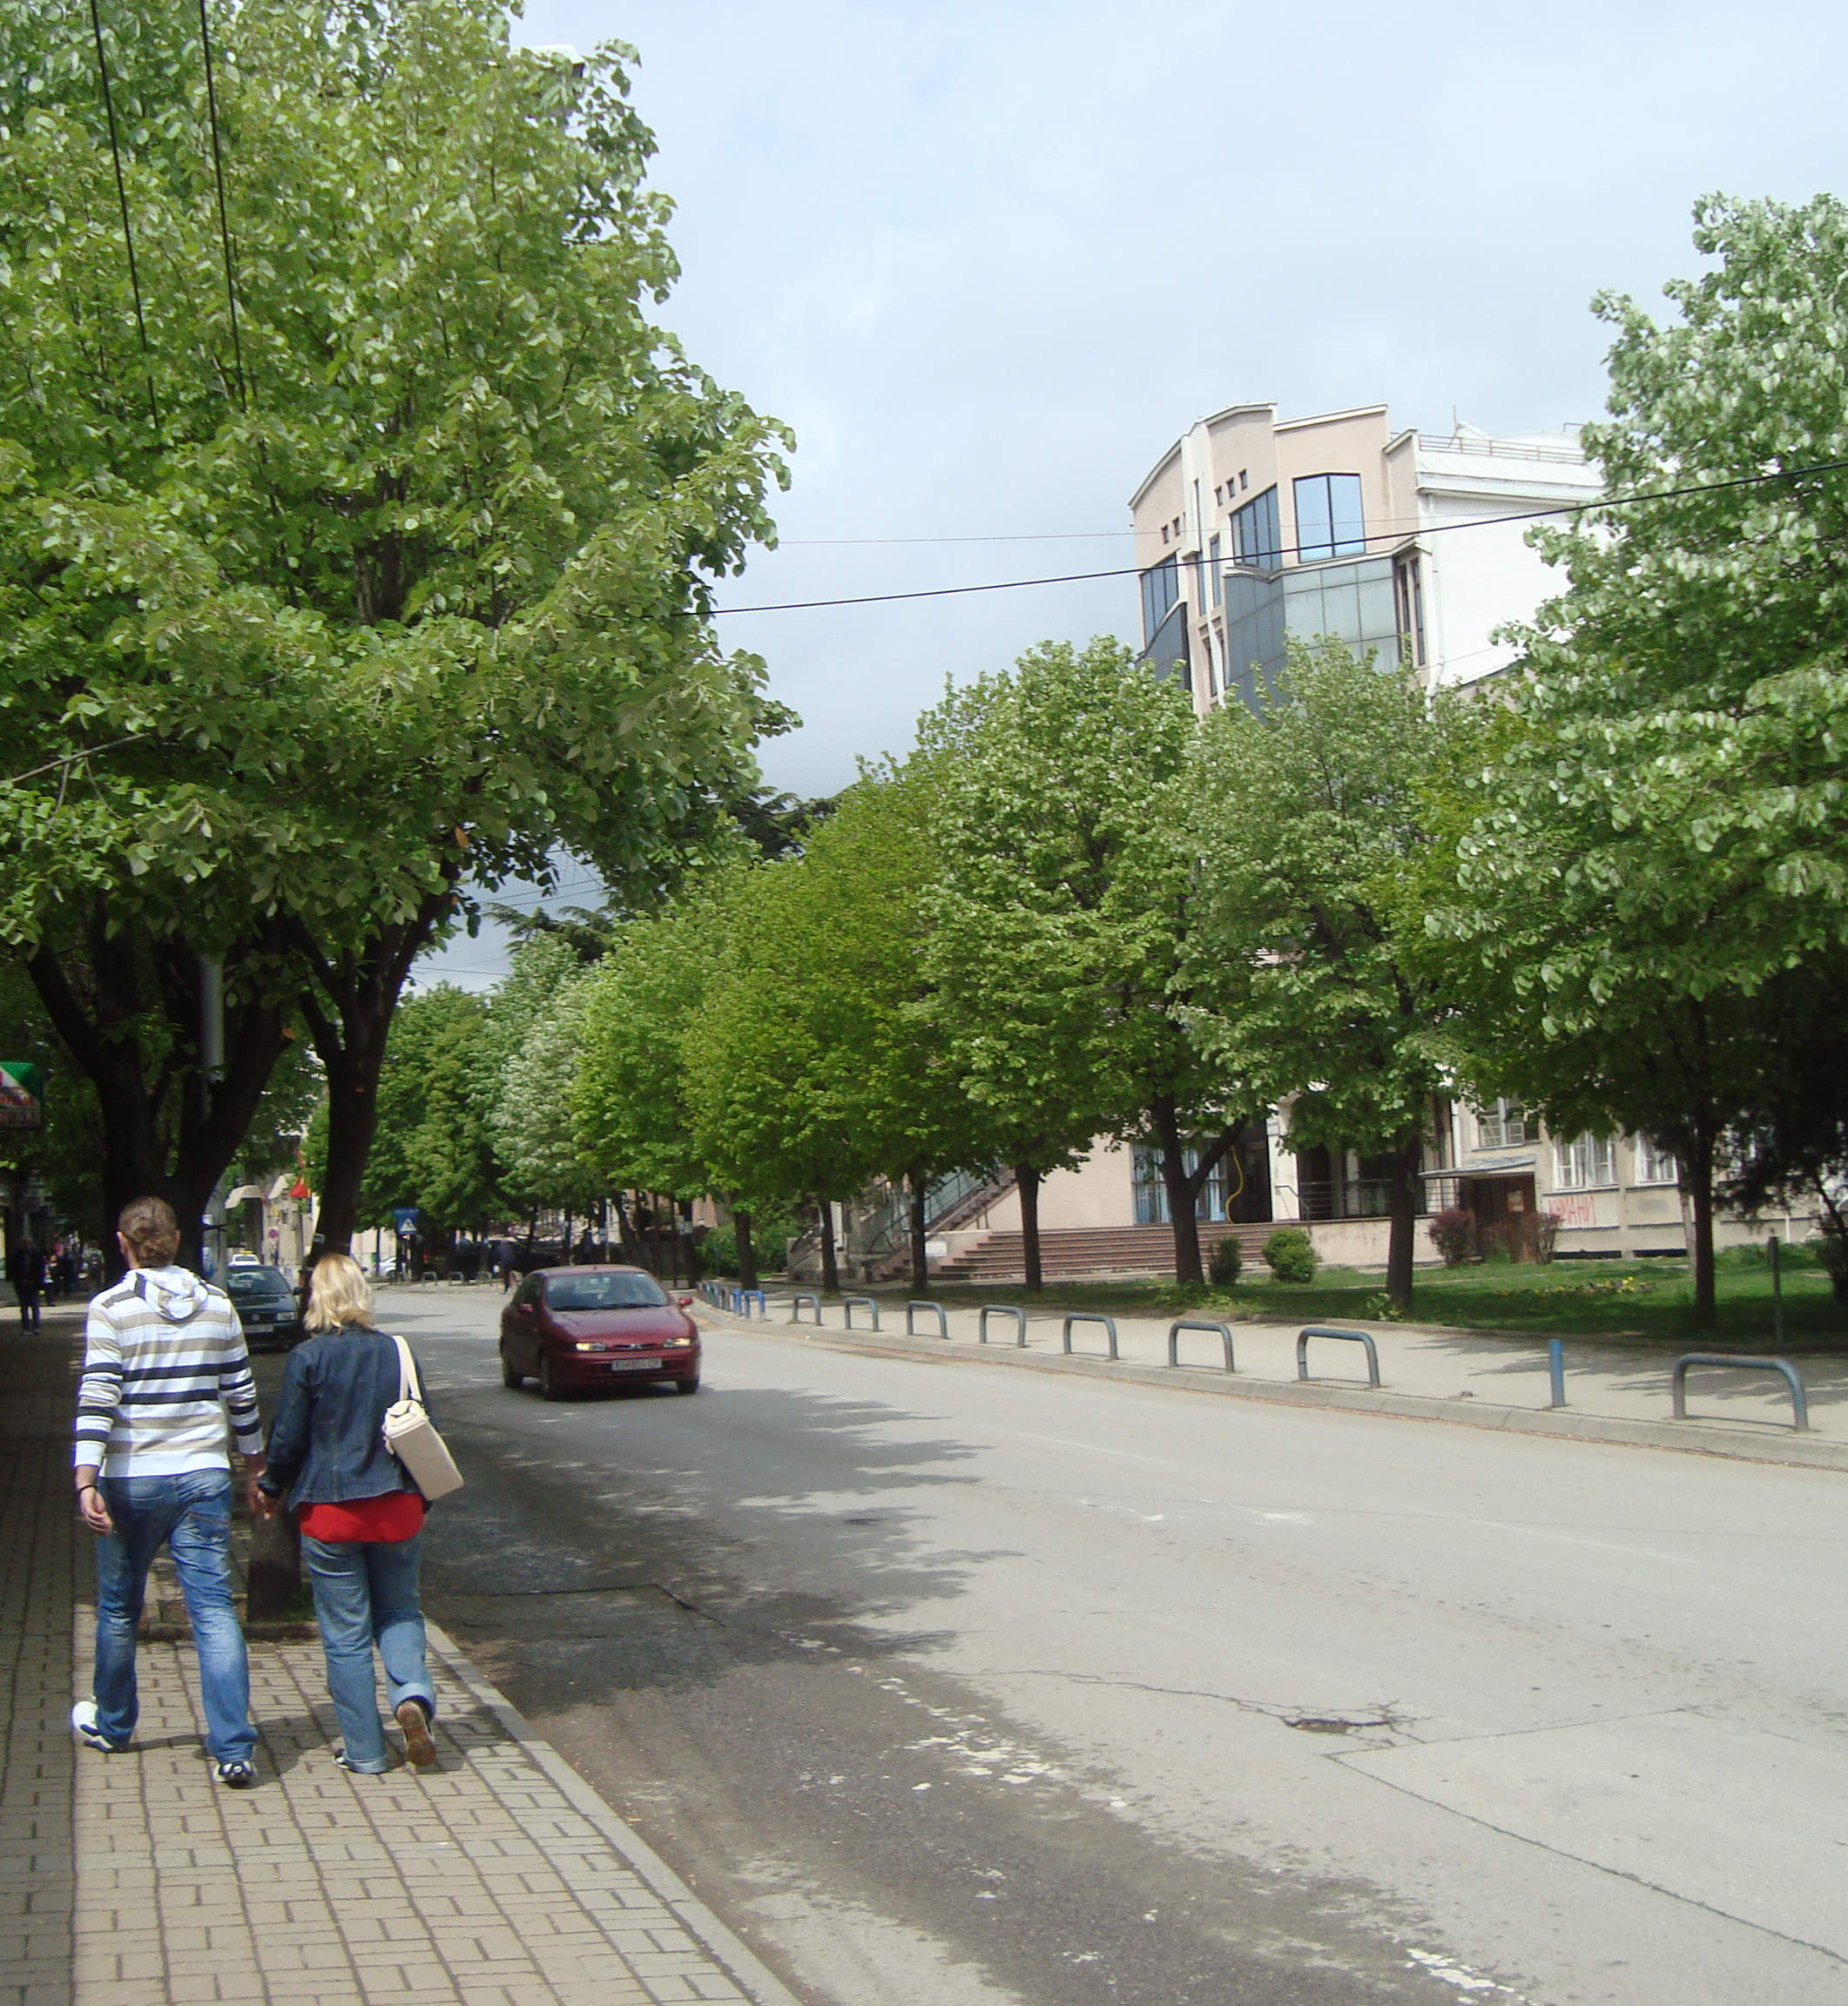
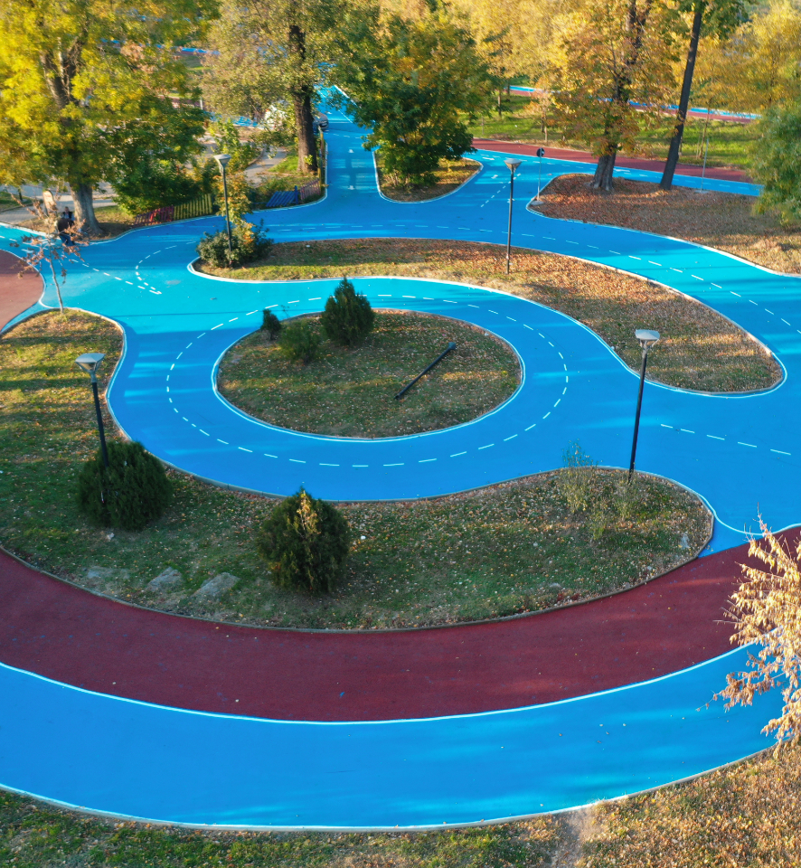

Slide 7
Thank you for attention !

